Slide 1
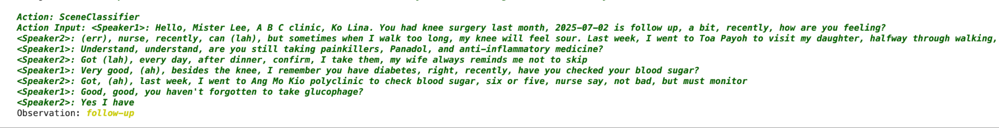
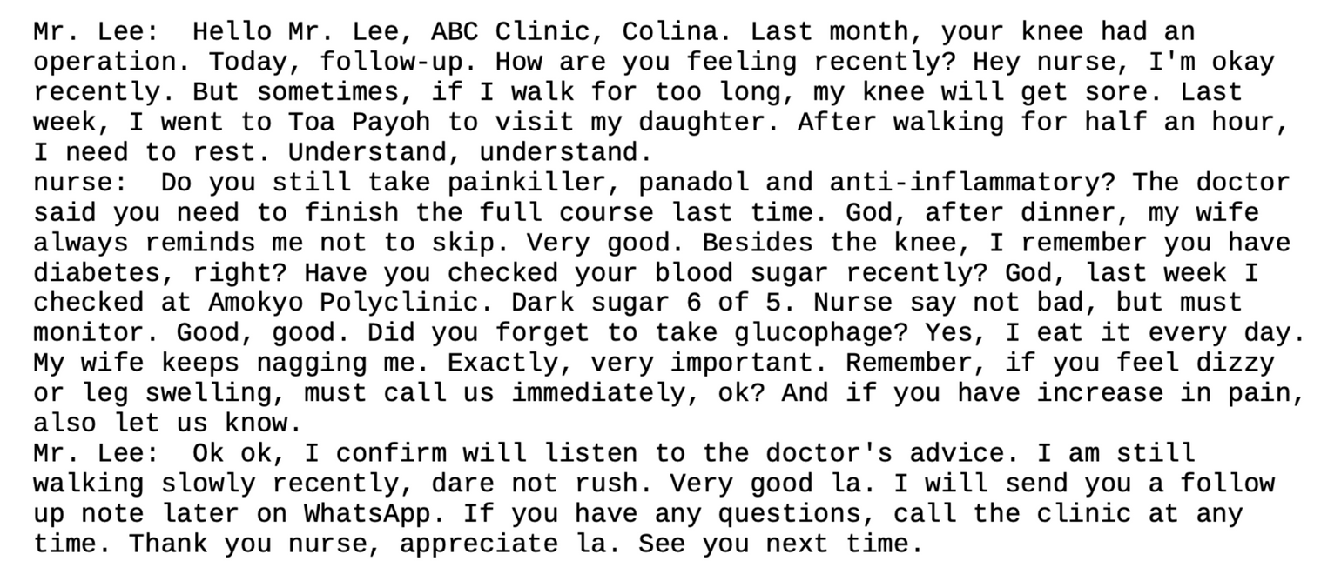
Comparison between h2ogpte & Meralion
Meralion
H2Ogpte
Meralion can correctly detect Singapore location name like “Ang Mo Kio”, while h2ogpte transcribe it as “Amokyo”
H2Ogpte can’t identify speakers during a dialogue

Slide 2
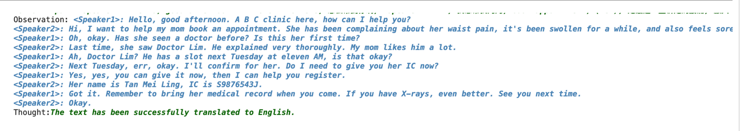
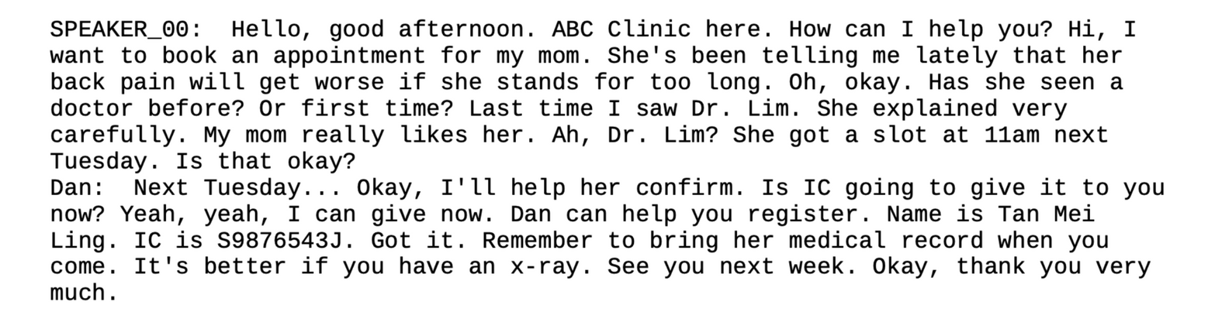
Comparison between h2ogpte & Meralion
Meralion
H2Ogpte
Meralion can correctly detect “waist pain”, while h2ogpte misunderstand it as “back pain”
Meralion can do the translation more naturally than h2ogpte, especially when the original input is inverted sentence.
Do I need to give you her IC now?
vs
Is IC going to give it to you now?

Slide 3
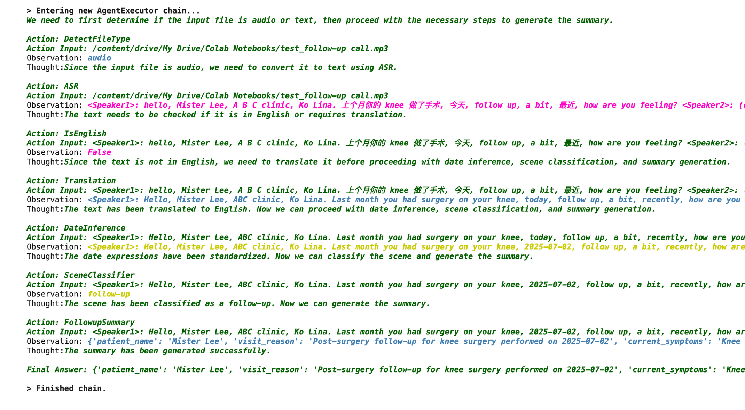
Chain of Thoughts for the Agentic Workflow

Slide 4
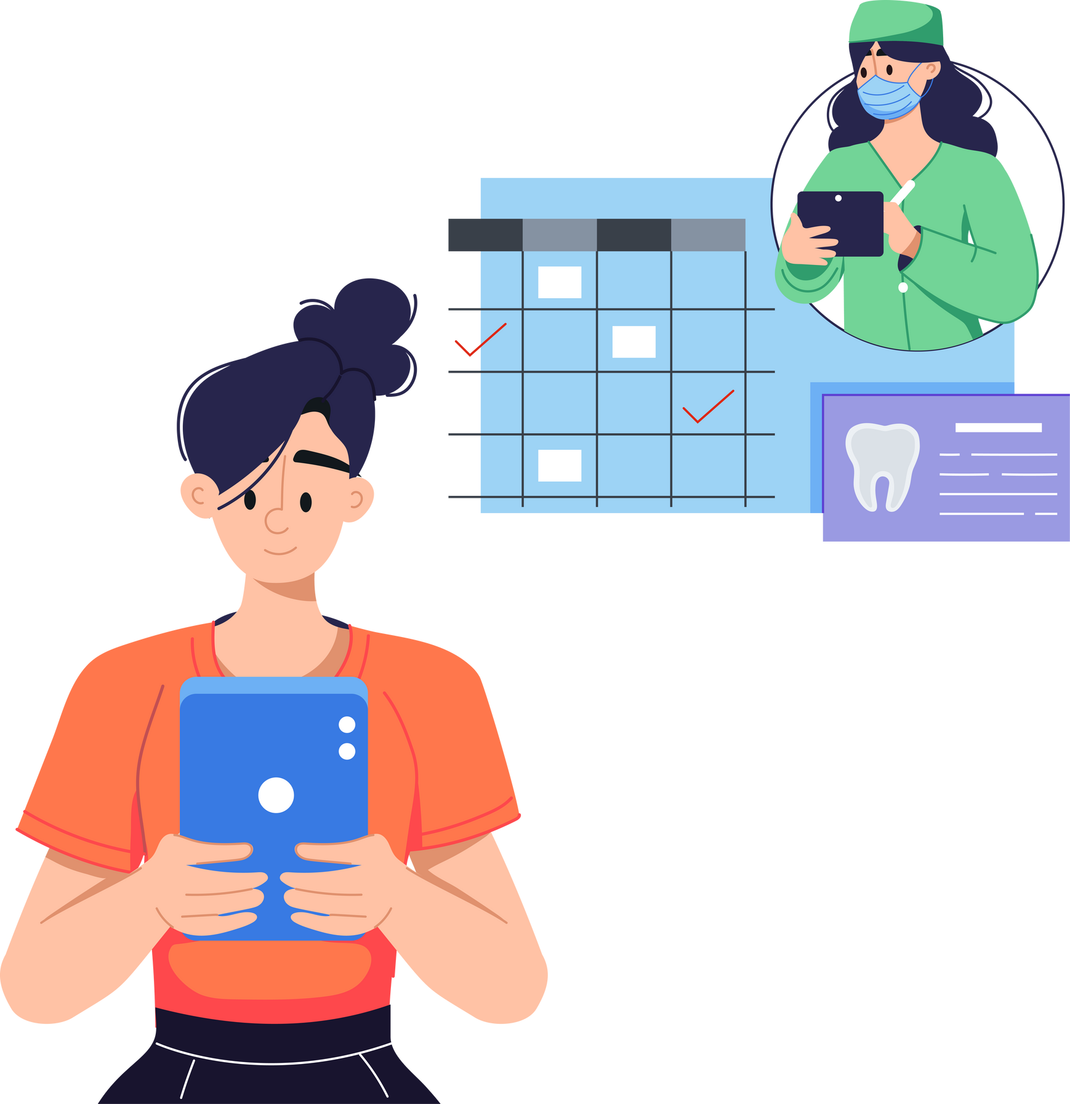
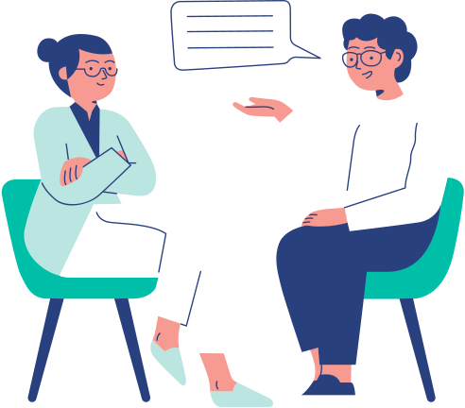
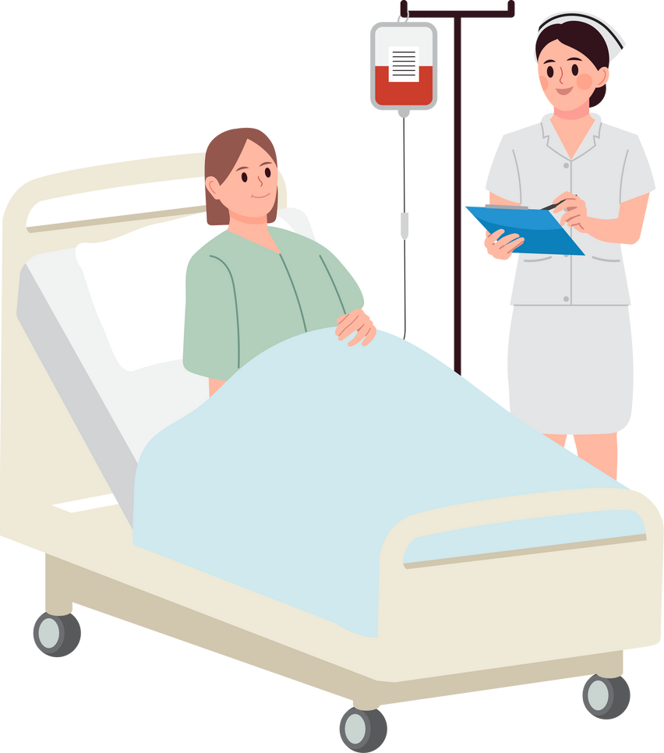
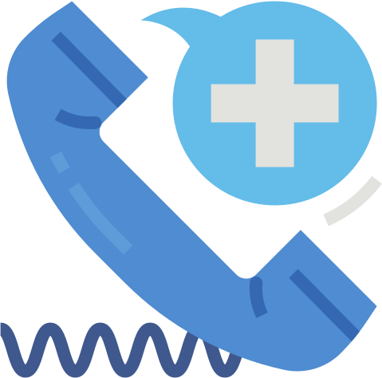


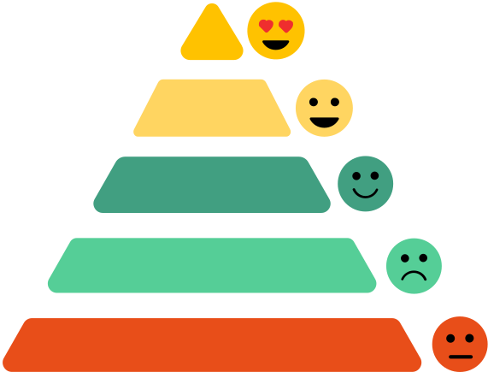



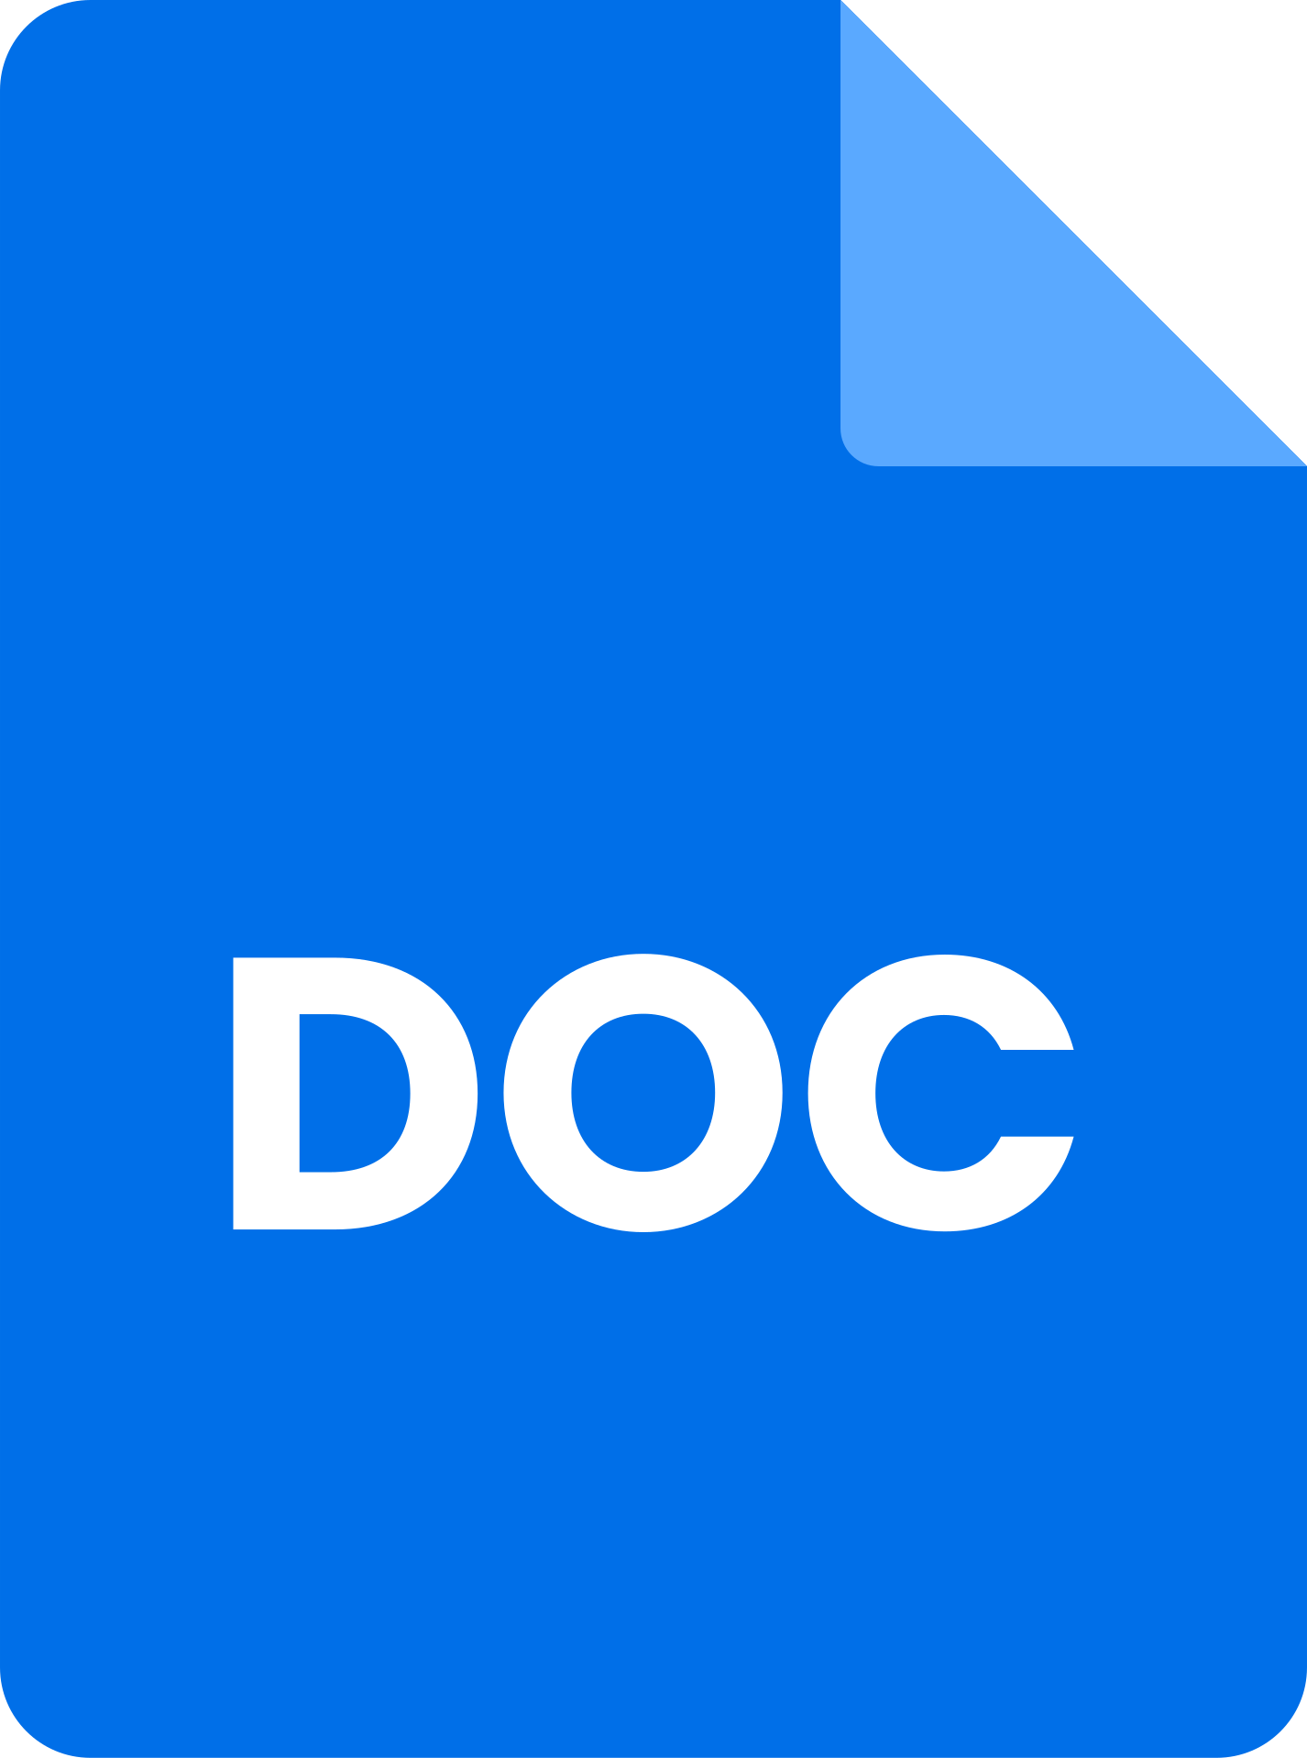
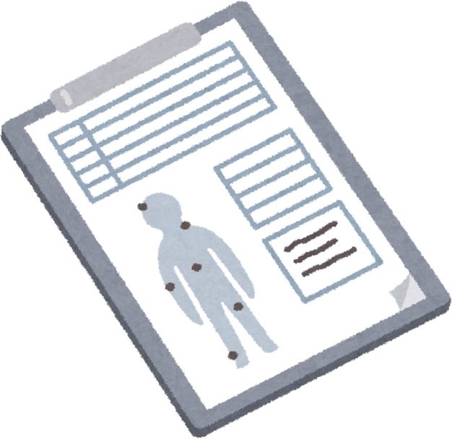

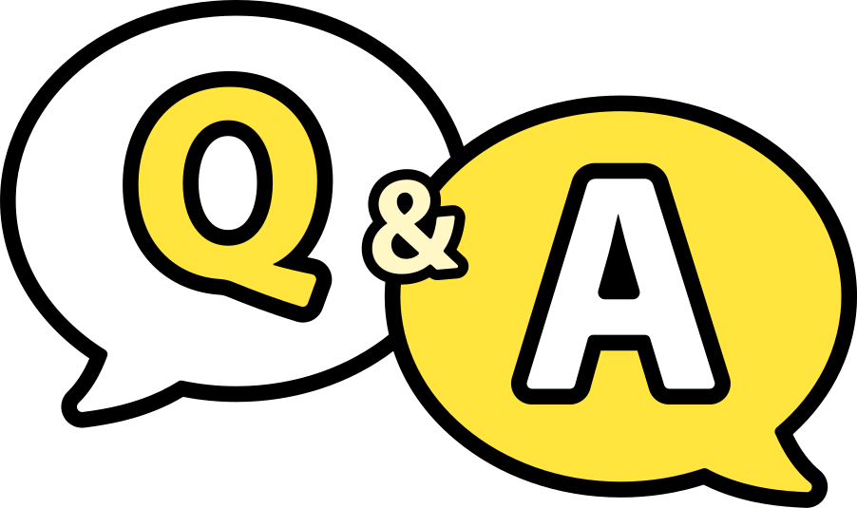

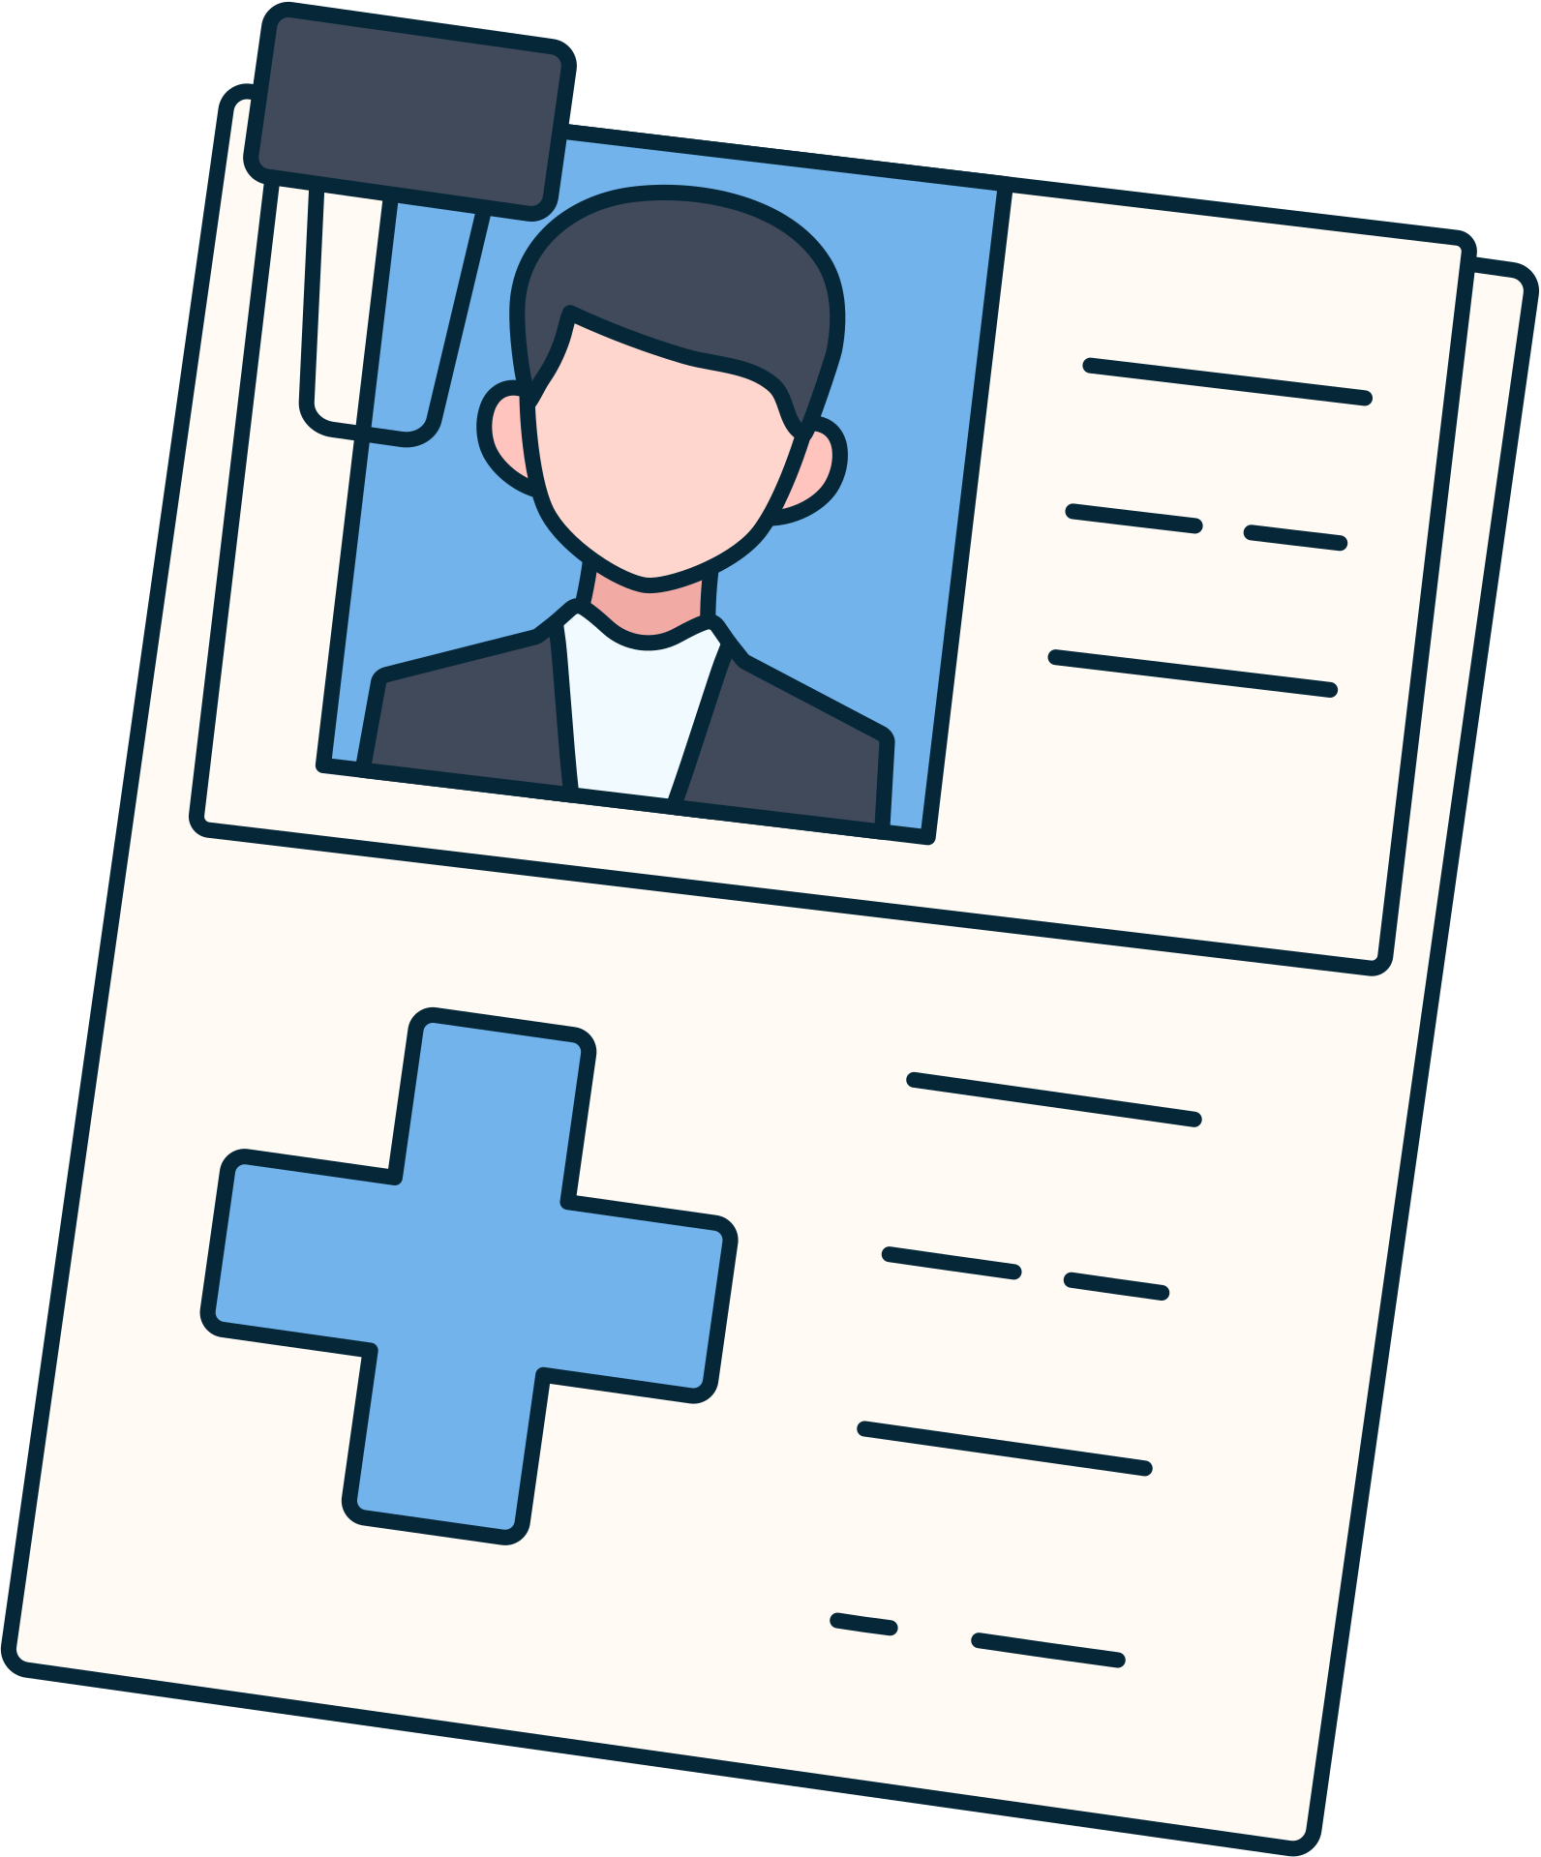



Framework
Multimodal Input
Audio
Appointment Call
On-site
Consultation
Ward Round
Hotline
MERaLION
Paralinguistic Features Detection
ASR
Text
Structured Files Generation
Electronic
Medical
Report
TTS
Storage
Referral Letter
RAG-based
Patient
Collection

Slide 5

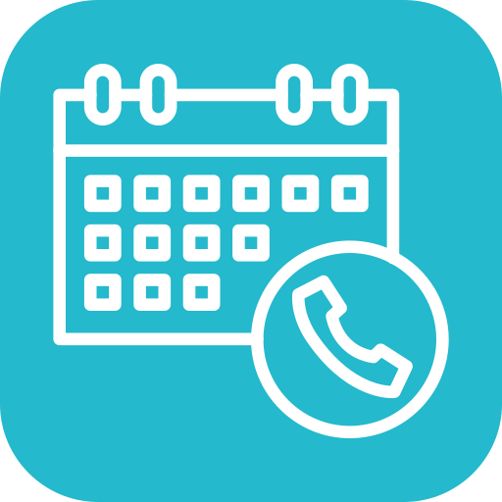
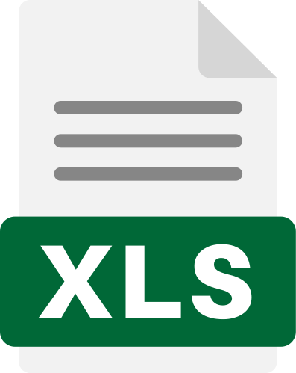






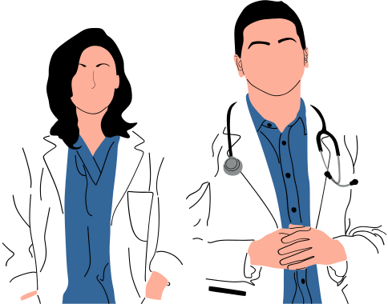

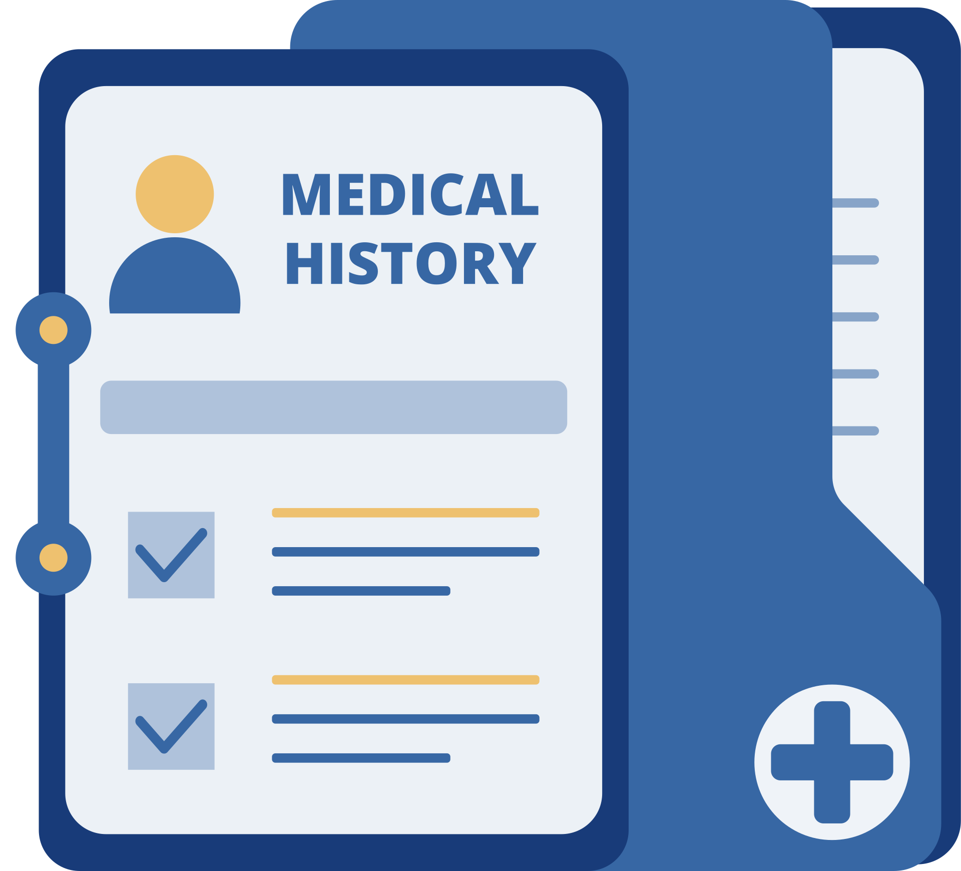

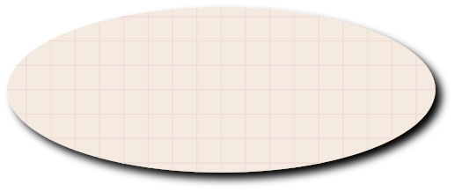

Scenario 1 - Appointment Call
What’s your [basic info] ?
name
nric
symptoms
appointment time
doctor
Any available time slot for appointment?
Automatically extract key information
and populate Excel sheets as schedule
Transcribe appointment calls
Pre-briefing
Allowing doctors to quickly access patient history
before consultations
Create records for new patients
and store them in their collections

Slide 6
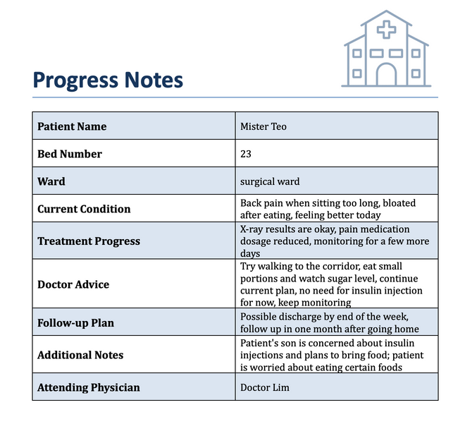



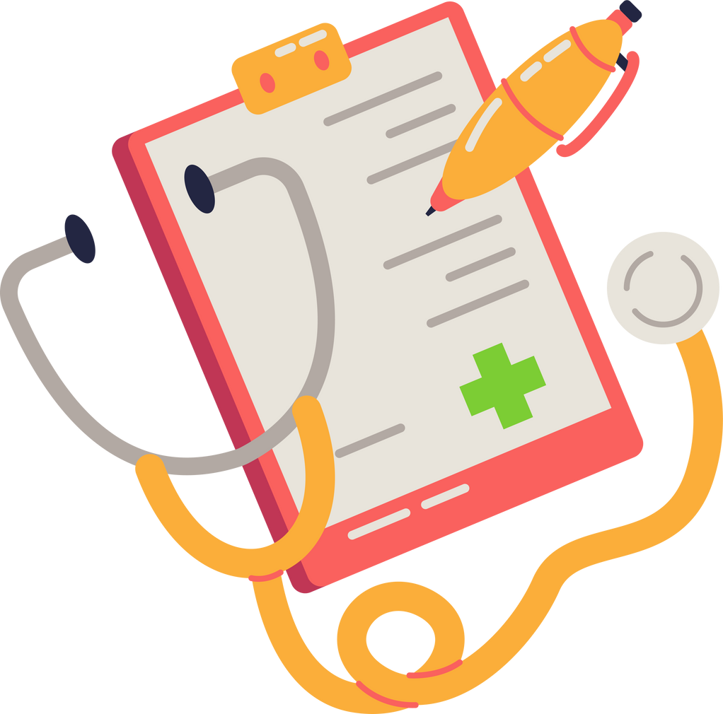
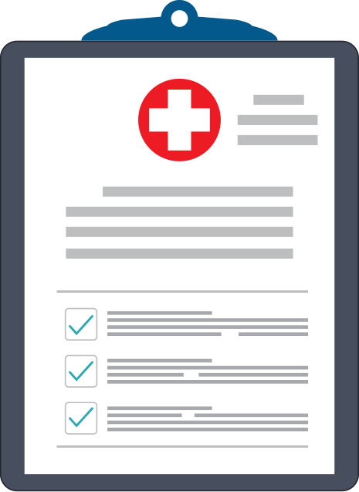

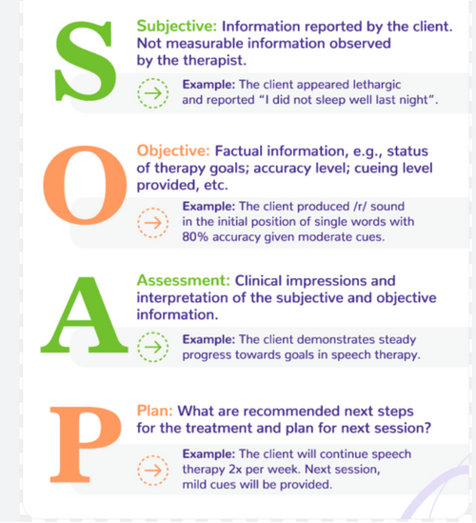
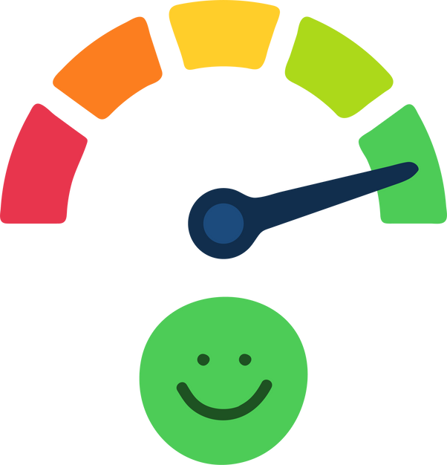
Scenario 2 - Bedside consultation
Record Inpatient ward round
Auto-generate clinical notes
One-click summaries for multispecialty collaboration
Monitor patient emotions to provide personalized advice
Automatically upload records for patients
in their related collections

